Slide 1
Communication in Shared and Distributed Memory
CS121 Parallel Computing
Spring 2021

Slide 2
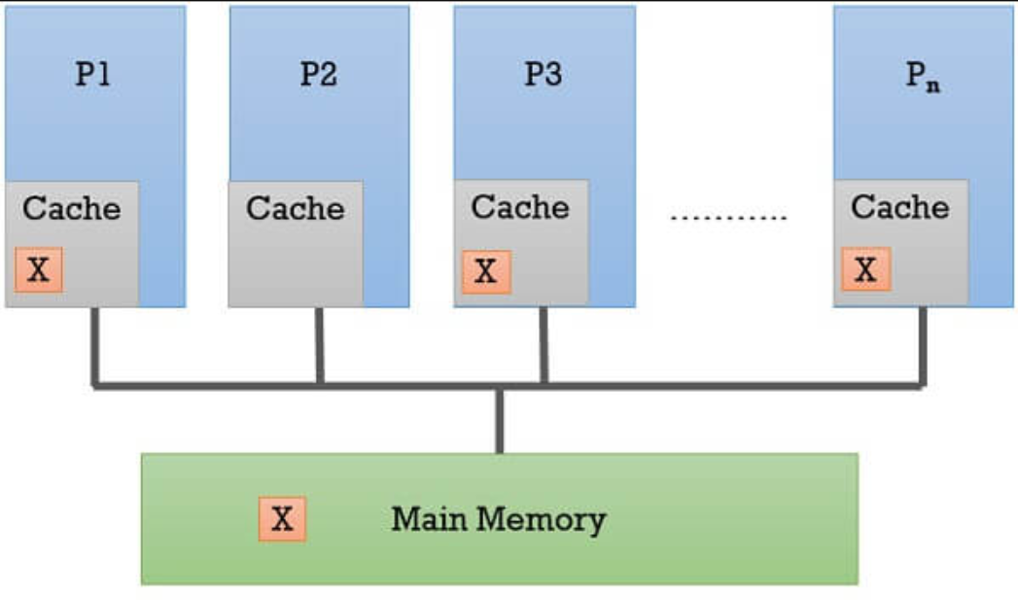
The cache coherence problem
In shared memory systems, there is only one logical copy of each variable.
If several processors want to access the variable, they can each store it in their cache, to avoid latency to access main memory.
But when one processor modifies the variable, other processors must be aware of the change.
Since the variable is stored in multiple caches, the caches have be made coherent through some procedure / protocol.

Slide 3
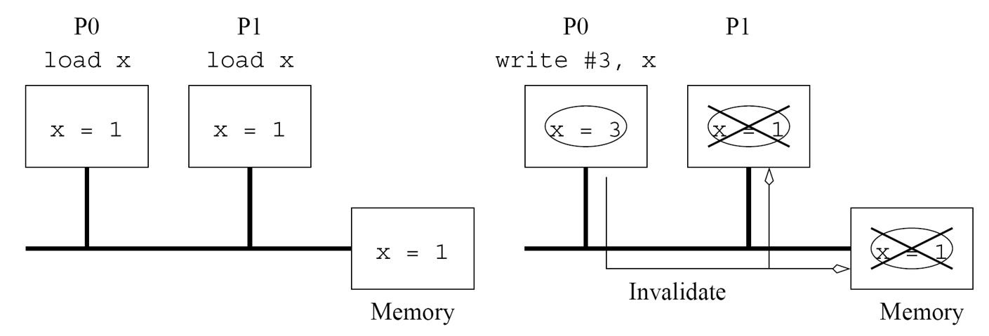
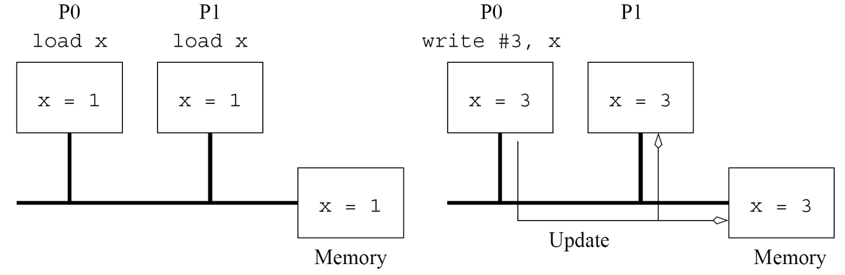
Cache coherence protocols
Two main types of protocols, invalidate and update.
Invalidate When one process modifies variable, all other cached copies and copy in memory are declared invalid.
If another process wants to access the variable, first process writes back new value to memory, and second process reads from memory.
Update When one process modifies variable, it writes new value to other caches and memory.
Invalidate and update tradeoff communication vs speed.
If other processes don’t read the variable, update wastes communication.
If other processes do read the variable, invalidate causes stall for writeback and read.
Since bandwidth is limited in parallel systems, most use invalidate.
Source: Introduction to Parallel Computing, Grama et al.

Slide 4
MSI protocol
Invalidation based coherency protocol.
The basis for widely used and higher performance protocols, e.g. MESI and MOESI.
A variable X can be in the M (modified), S (shared) or I (invalid) state.
When a processor performs an action (e.g. read or write), it may cause a state change and coherence messages to be sent to the main memory and all other processors.

Slide 5
MSI protocol
S (shared): X may exist in multiple caches.
X’s value hasn’t changed since last time each processor read X from main memory.
All copies of X are up to date.
Processors can continue to read X from own caches.
M (modified / dirty) state
A processor p changed its cached value of X.
p must inform other processors their cached X value now invalid.
p can still read / write to X in its own cache.
When p evicts X, must write back (flush) its latest value to main memory.
I (invalid): Another processor has changed X’s value.
This processor’s value for X is out of date.
Must read X from main memory.
When reading X, will cause processor holding X in M state to first write its value to main memory.

Slide 6
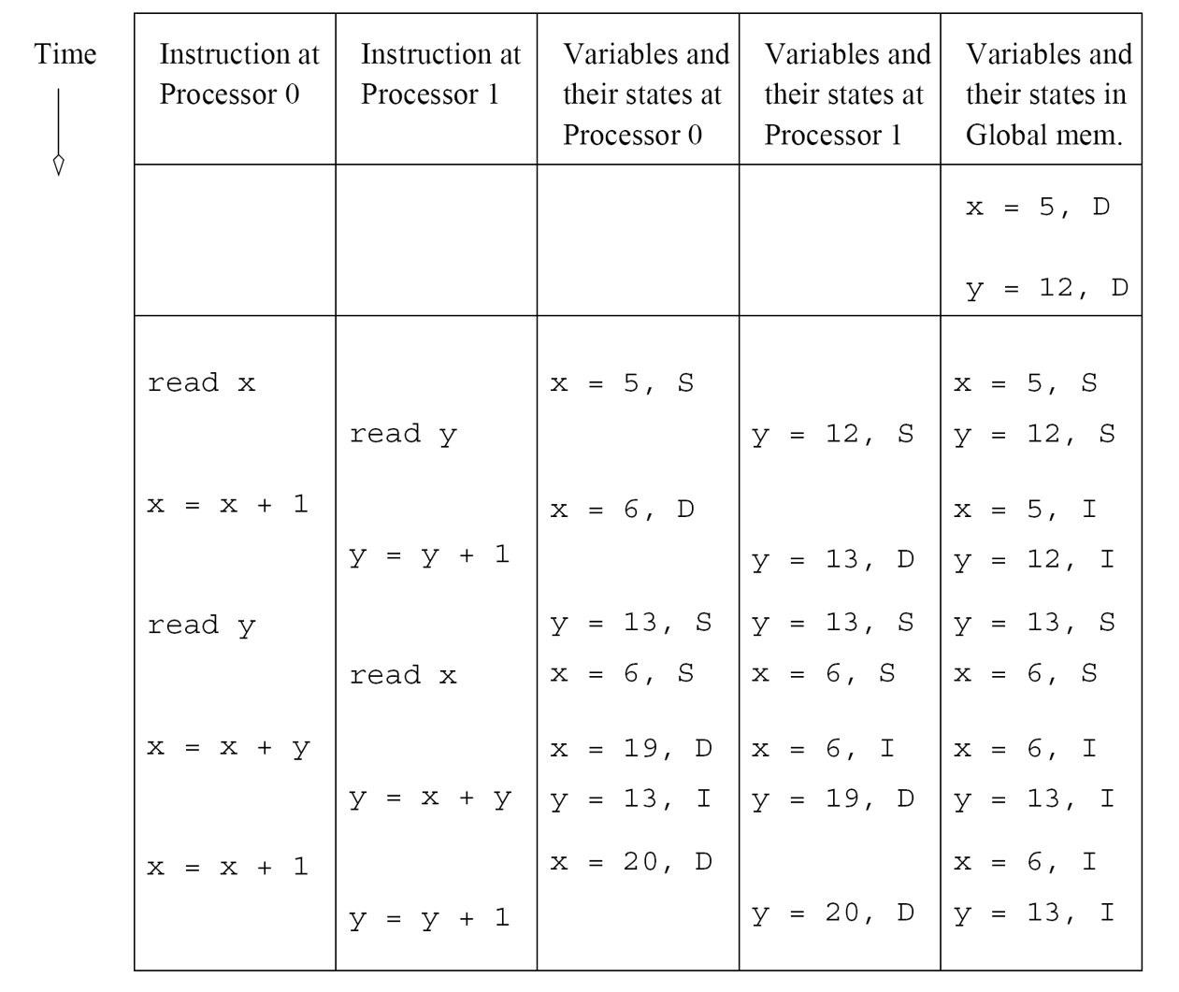
MSI example

Slide 7
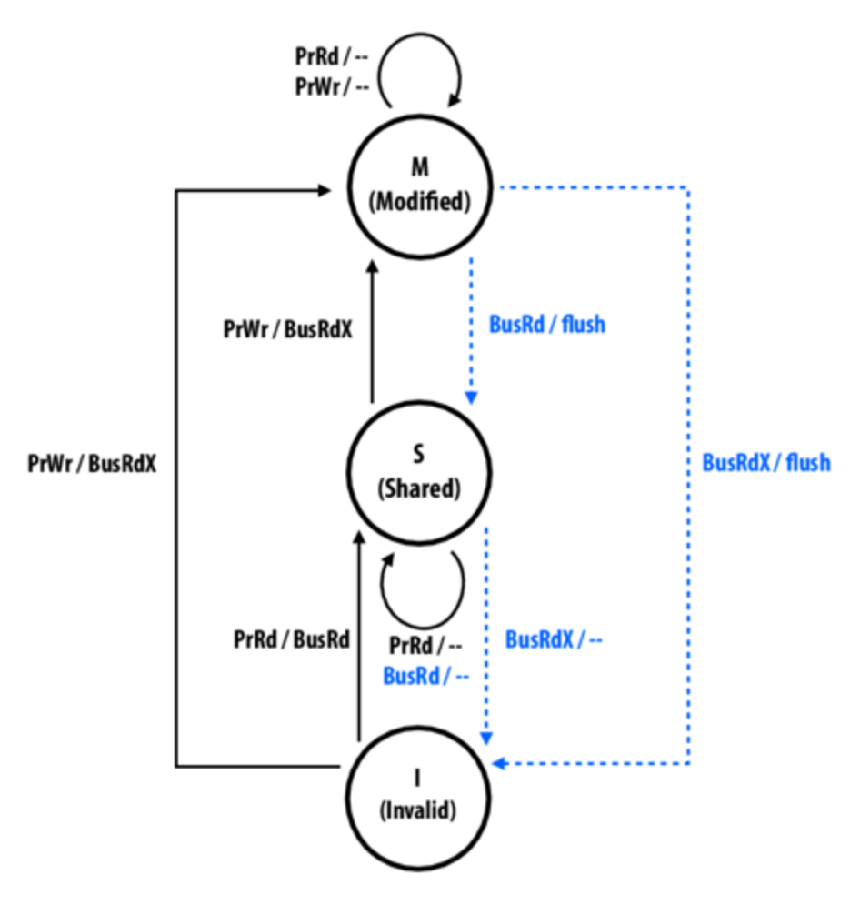
MSI state machine
A / B: Input request A, output action B.
Processor messages in black
Bus messages in blue.
PrRd: processor read request
PrWr: processor write request
flush: processor writes back data to memory
BusRdX: obtain copy with intent to modify
BusRd: obtain copy of var with no intent to modify
Examples
Var currently shared. Proc writes new value (generates PrWr), leading to BusRdX msg. Proc goes to M state. All other procs (currently in S state) go to I state.
Var currently dirty (last updated by a proc in M state). Proc in I state wants to read var (generates PrRd), leading to BusRd msg. Proc in M state flushes current var value to memory. All procs go to S state.
Proc in M state wants to read / write. Generates PrRd / PrWr local message, but no bus messages. Hence no coherence traffic.
Source: http://15418.courses.cs.cmu.edu/spring2015content/ lectures/10_cachecoherence1/

Slide 8
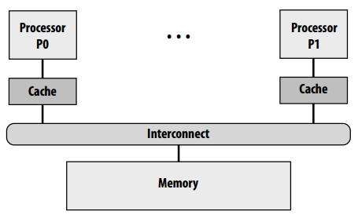
Snoopy cache system
MSI (and other protocols) can be implemented on different types of hardware.
A basic (i.e. cheap) setup is a snoopy coherence protocol implemented on a bus or ring.
All processes listen on the bus for coherency traffic and respond accordingly.
Protocol works correctly because messages are broadcast on bus, so all processes hear all messages.
If only one processor modifies a variable, all accesses are to its cache, and no coherence traffic ⇒ good performance.
If multiple processors modify the variable, many flushes and coherency traffic ⇒ bus becomes performance bottleneck.

Slide 9
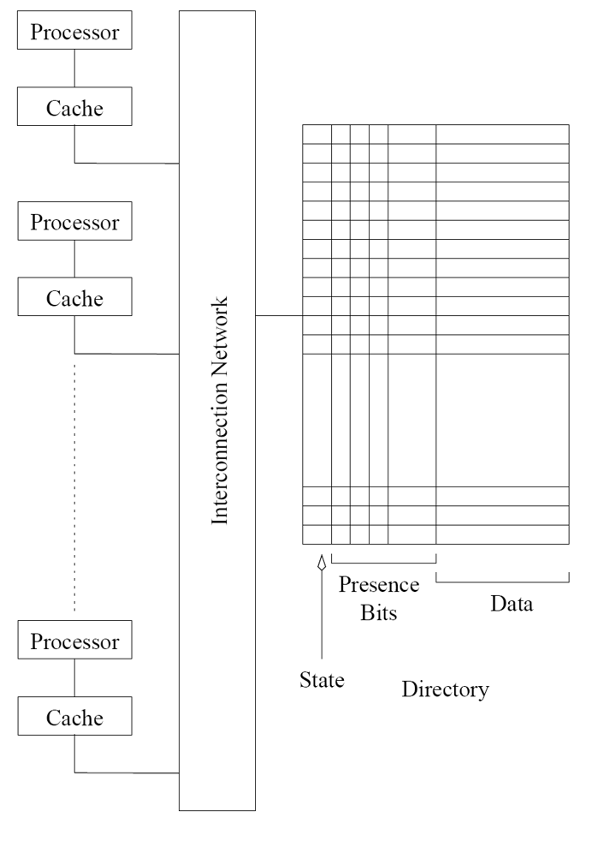
Directory cache system
Based on observation that only processors with shared or dirty copy of variable need to hear its coherence messages.
Keep a directory data structure in memory, indicating for each memory block which processors hold shared or dirty copies.
Given p procs, for each memory block use p bits indicating processors relevant for the block.

Slide 10
Example
Initially several procs hold var X in S state. They’re marked in X’s presence bits in directory.
Proc 0 modifies X. Main mem and all present procs besides proc 0 recv invalidate msg.
All their presence bits for X are reset; only proc 0 still present in directory.
Later (invalid) proc 1 reads X. Since proc 1 in I state, it reads directory, finds proc 0 in M state, and causes proc 0 to flush X.
Procs 0 and 1 marked in directory in S state.

Slide 11
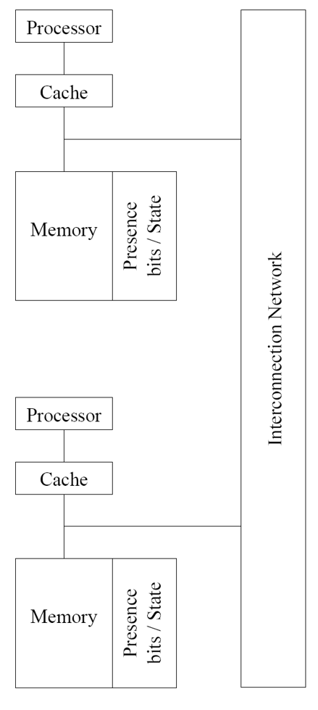
Distributed directory cache
Since directory stored in memory, all coherency traffic access memory, which becomes bottleneck.
Also, directory needs large O(mp) amount of storage, m = # memory blocks, p = # processors.
To improve performance, distribute directory among the processors.
Each processor handles a fixed memory range, and stores directory for the range.
Processor needing directory info on a var queries processor responsible for the var.

Slide 12
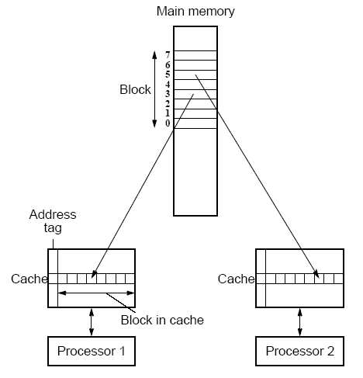
False sharing
Data transferred into / from cache in units of cache lines (aka blocks).
Typical L1 cache line size is 64-128B.
Multiple words fit into one cache line.
Processors accessing different words can access same cache line.
If one processor modifies cache line, other processors with same cache line must be updated or invalidated.
Padding tries to lay out data so data accessed by different processors are in different lines.

Slide 13
Communication costs
First consider cost in message passing systems, then shared memory.
Time to transfer a message of size m from one node to another consists of
Startup time t_{s}: Prepare message header, error correction, running routing protocol, interfacing with router, etc.
Once per message.
Per hop time t_{h}: Used by router to determine next hop.
Per word transfer time t_{w}: If bandwidth is r, per word transfer time from source to dest is 1/r.

Slide 14
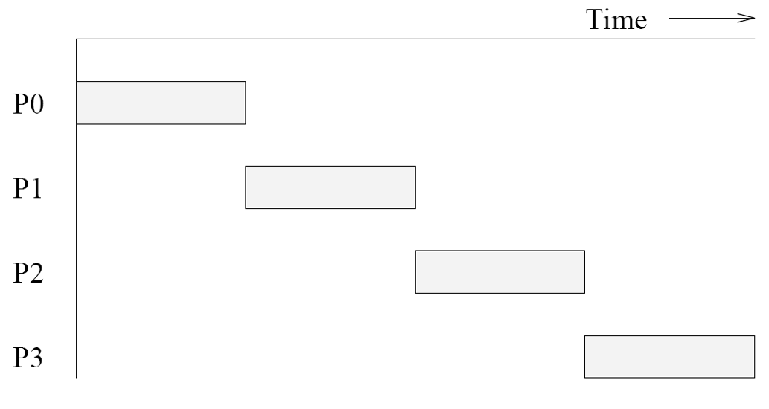
Store and forward routing
Each intermediate node waits to receive entire message before forwarding it to next hop on path.
Takes m t_{w}+t_{h} time per link, so for l links t_{s}+ l(m t_{w}+t_{h}) total time.
t_{h} small compared to m t_{w}, so time is ≈ t_{s}+ l m t_{w}.

Slide 15
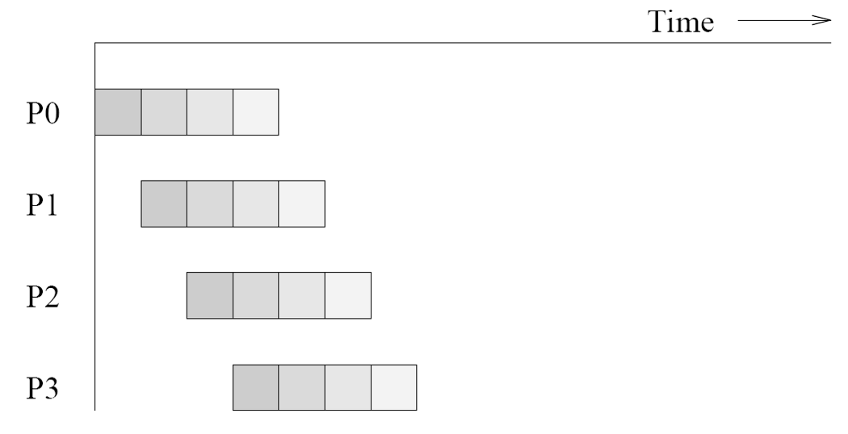
Packet routing
Break large message into small packets.
Intermediate node can receive a packet as soon as it finishes forwarding previous packet it received.
Pipeline parallelism.
Also lets packets take different routes, and easier error correction.
Essential for Internet, with unpredictable network state, high error rates.
But overhead from each packet’s routing info, error correction, sequence number etc.
Total time t_{s} + t_{h} l + t_{w} (m+l-1).
First packet arrives at time t_{s} + t_{h} l + t_{w} l.
Remaining m-1 packets arrive every t_{w} time.

Slide 16
Cut-through switching
Similar to packet routing, but optimized for parallel computers.
Messages take same path. No routing info.
Small (~ 32B) flits (flow control digits) transmitted at high rate.
First flit (header) is allocated path by switches / routers. Remaining (body and tail) flits follow same path.
Simple, per message (instead of per packet) error correction.
To reduce latency for high priority flits (e.g. cache lines), use multilane cut-through routing.
Also called virtual cut-through. A related technique is wormhole routing.

Slide 17
Overall cost model
Total communication time depends on data volume m and number of hops l.
However, programmer has little control over l.
Usually can’t control process to processor mapping.
Many systems use randomized two step routing to minimize congestion: first send message to random node, then send it to destination.
Per hop time t_{h} usually small compared to t_{s} or m t_{w}.
Communication time can be simplified to t_{s}+m t_{w}.
Assumes uncongested network.
If congestion on link is c, i.e. c messages are sent over the link, time becomes t_{s} + c m t_{w}.
Ex √p x √p mesh where nodes randomly communicate with each other.
Across a bisection there are O(p) communications.
But mesh bisection width is √p.
So some link carries O(p) /√p = O(√p) messages.
So communication time is t_{s} + O(√p m t_{w}).

Slide 18
Comm cost in shared memory
Shared memory communication costs are more unpredictable.
Memory layout determined by system. Hard to estimate amount of local / remote memory accesses.
Cache thrashing depends on scheduling and process allocation.
Coherency traffic, spatial locality and false sharing also very nondeterministic.
But to first order, still model communication time as t_{s} + t_{w}m.
t_{s} and t_{m} are much smaller in shared memory than distributed memory architectures.

Slide 19
Routing
We saw interconnection networks such as mesh, hypercube, tree, etc. How do processes communicate on these networks?
Routing algorithm selects a path between two communicating processes.
Routes are ideally short, uncongested and easy to compute. But tradeoffs exist.
Ex Short (minimal) routes may be more congested.
Ex Deterministic, i.e. fixed given source and destination, or adaptive, i.e. route around congestion.

Slide 20
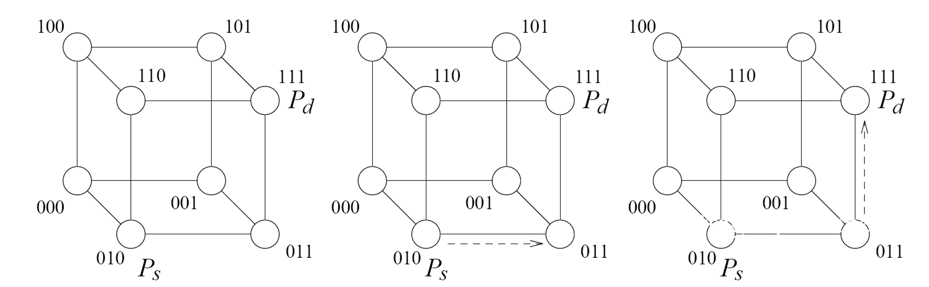
Dimension and E-cube routing
Dimension routing for a k-dim mesh orders the dimensions (e.g. XYZ) and routes messages in order of dimension.
E-cube routing does dimension routing on dimensions of a hypercube.
Let s, d be bit representations of source and destination.
Compute r = s XOR d, and from least to most significant digit of r, route along dimensions with 1-bit.
Ex Routing from 010 to 111.

Slide 21
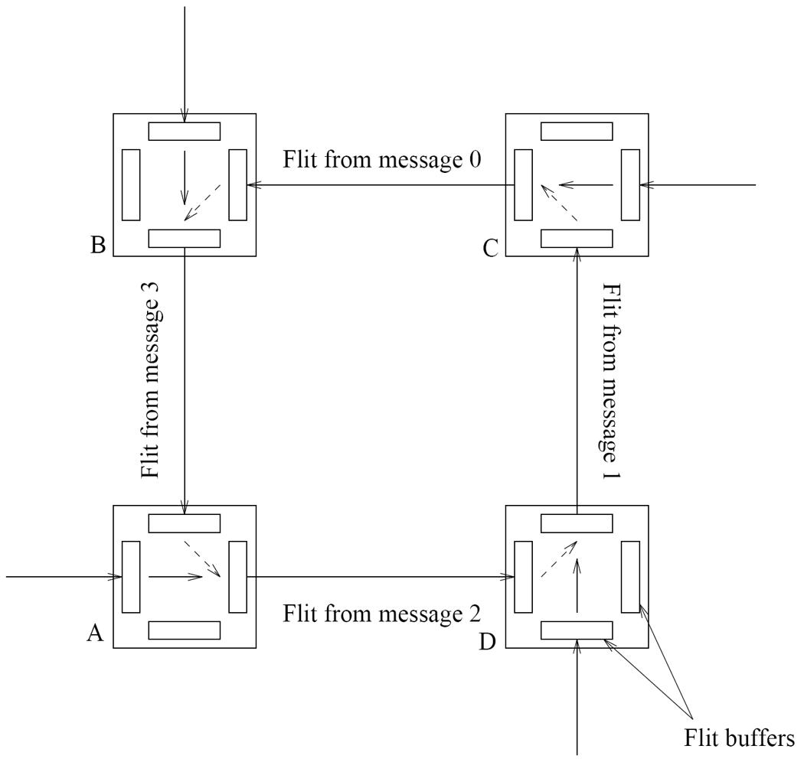
Deadlocks
Dimension and E-cube routing prevent deadlocks.
Ex Without dimension routing.
A→D→C, D→C→B, C→B→A, B→A→D
A’s flit can’t move from AD to DC, because DC is occupied by D’s flit.
D’s flit can’t move from DC to CB, because CB is occupied by C’s flit. Etc.
With XY routing
A→D→C, D→A→B, C→B→A, B→C→D.
A and C’s flits first move along X dim, then B and D’s flits.

Slide 22
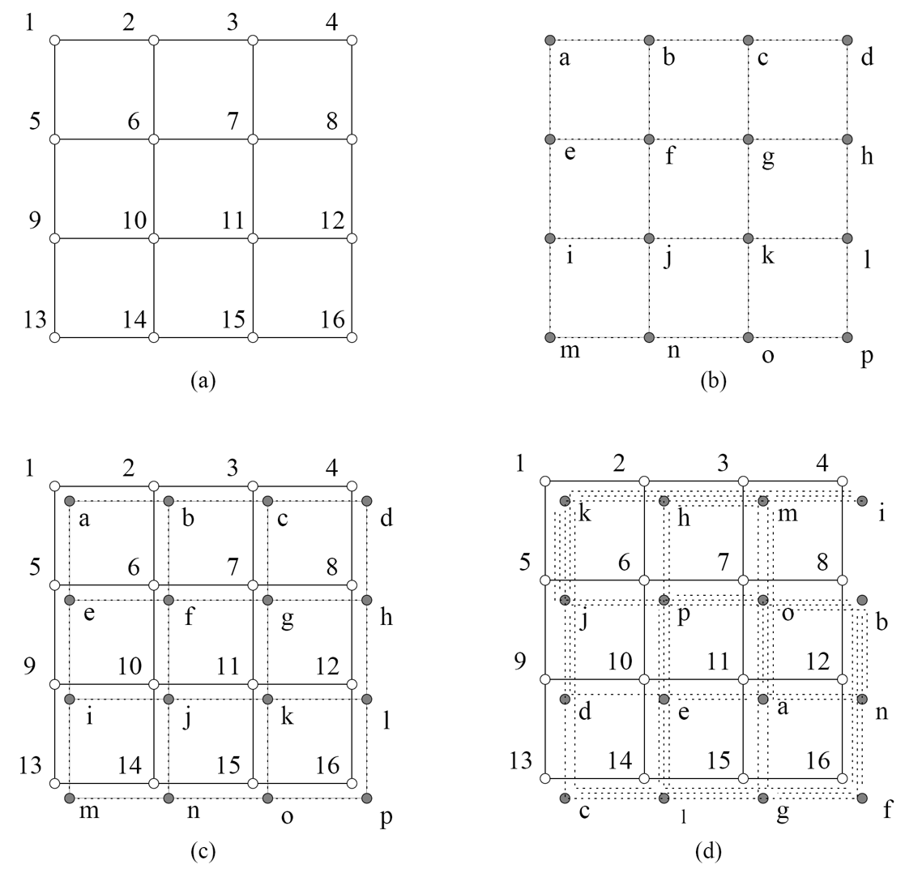
Process-processor mappings
Process communication pattern determined by the program.
Processor communication pattern determined by the hardware.
To run a program on a piece of hardware, must map processes to processors.
Poor mappings can cause communication bottlenecks, reduce performance.
Ex (a) and (b) show processor and process communication patterns.
Mapping (c) causes no bottlenecks.
Mapping (d) creates bottlenecks at links 15, 23, etc.

Slide 23
Embeddings
Give a map f from the graph P of process communication to graph R of processor communication pattern.
Each process of P maps to a processor in R.
Each edge from p₁ and p₂ in P maps to a shortest path between f(p₁) to f(p₂) in R.
Congestion is max number of routing paths that cross an edge in R.
Ex On previous example congestion = 5, e.g. on edge (1,5).
Dilation is max length of route between any two neighbors in P.
Ex On previous example dilation = 5, e.g. for edge (b,c).
Expansion is (# processes) / (# processors).
Assume for simplicity it is 1.

Slide 24
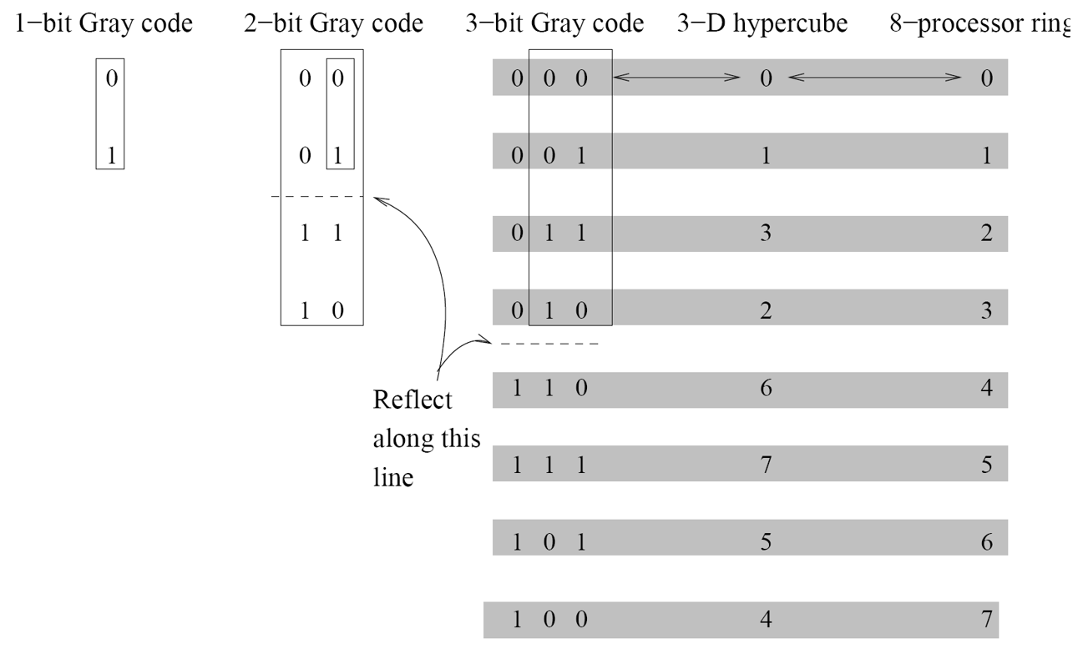
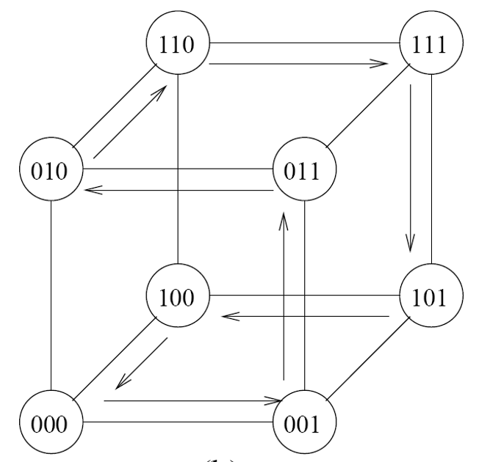
Line to hypercube
Map size 2^{k} line graph into k-dim hypercube.
Gray codes An ordering of k digit binary numbers where consecutive values differ in one digit.
Recursive construction Let G_{k-1} be a k-1 digit Gray code. Prepend G_{k-1} with 0. Then take another G_{k-1}, reverse it and prepend with 1. Concatenate the two copies.
Map node i in line graph to node G_{k}(i) in hypercube.
i and i+1 are mapped to neighbors in hypercube.
G_{k}(i) and G_{k}(i+1) differ in one bit, so are connected in hypercube.
So dilation is 1.
Each hypercube edge is mapped onto by at most one line graph edge.
So congestion is 1.

Slide 25
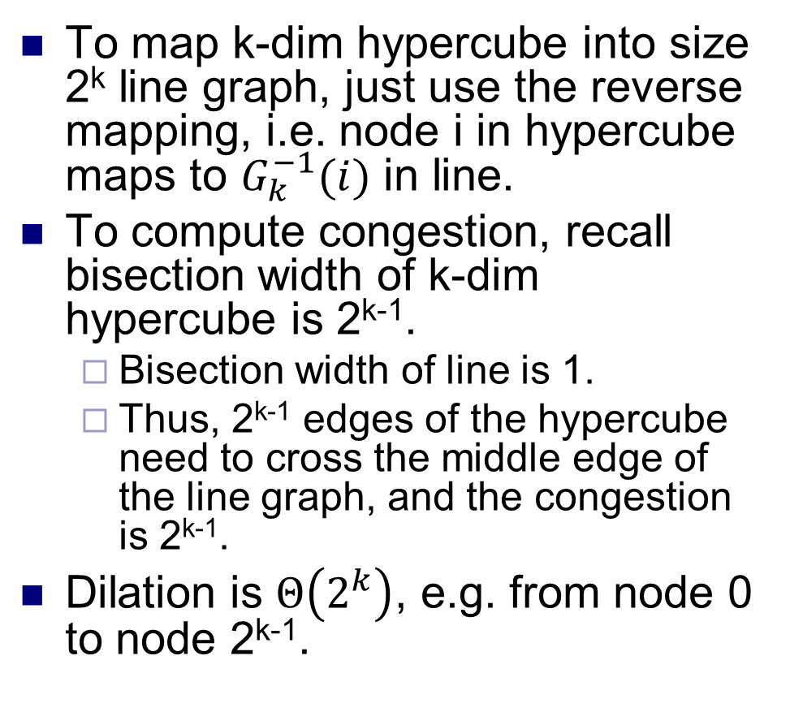
Hypercube to line
To map k-dim hypercube into size 2^{k} line graph, just use the reverse mapping, i.e. node i in hypercube maps to $G_{k}^{−1}(i)$ in line.
To compute congestion, recall bisection width of k-dim hypercube is 2^{k-1}.
Bisection width of line is 1.
Thus, 2^{k-1} edges of the hypercube need to cross the middle edge of the line graph, and the congestion is 2^{k-1}.
Dilation is $Θ\left(2^{k}\right)$, e.g. from node 0 to node 2^{k-1}.

Slide 26
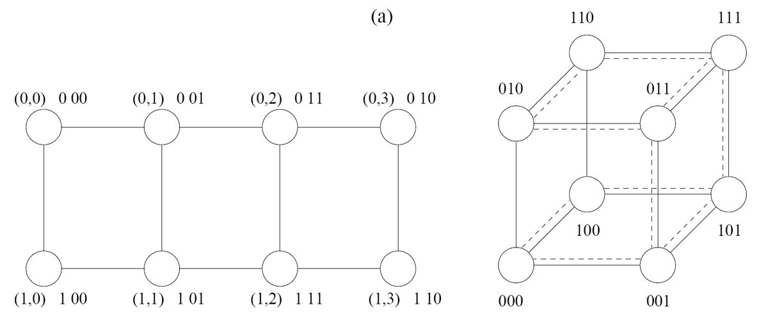
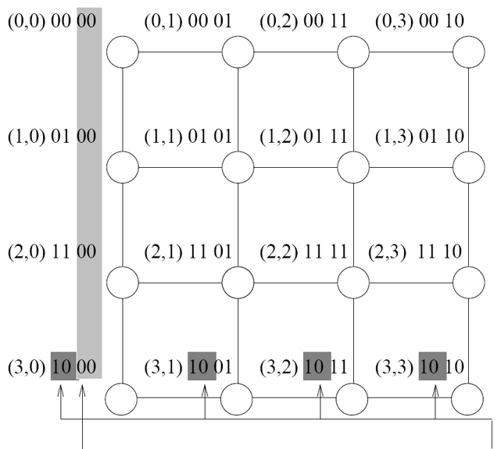
2D mesh to hypercube
Map a 2^{r} x 2^{s} mesh into an (r +s)-dim hypercube.
Map node (i, j) in mesh to node G_{r}(i) || G_{s}(j) in hypercube.
Neighbors in the mesh map to nodes that differ in one bit, i.e. neighbors in the hypercube.
So dilation and congestion are both 1.
Note that different rows and columns of the mesh map to distinct sub-hypercubes.

Slide 27
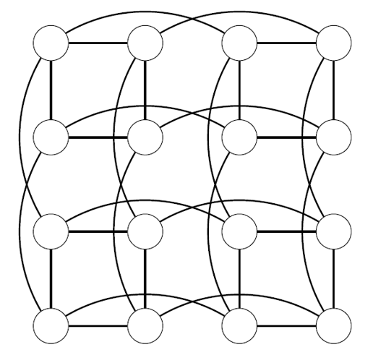
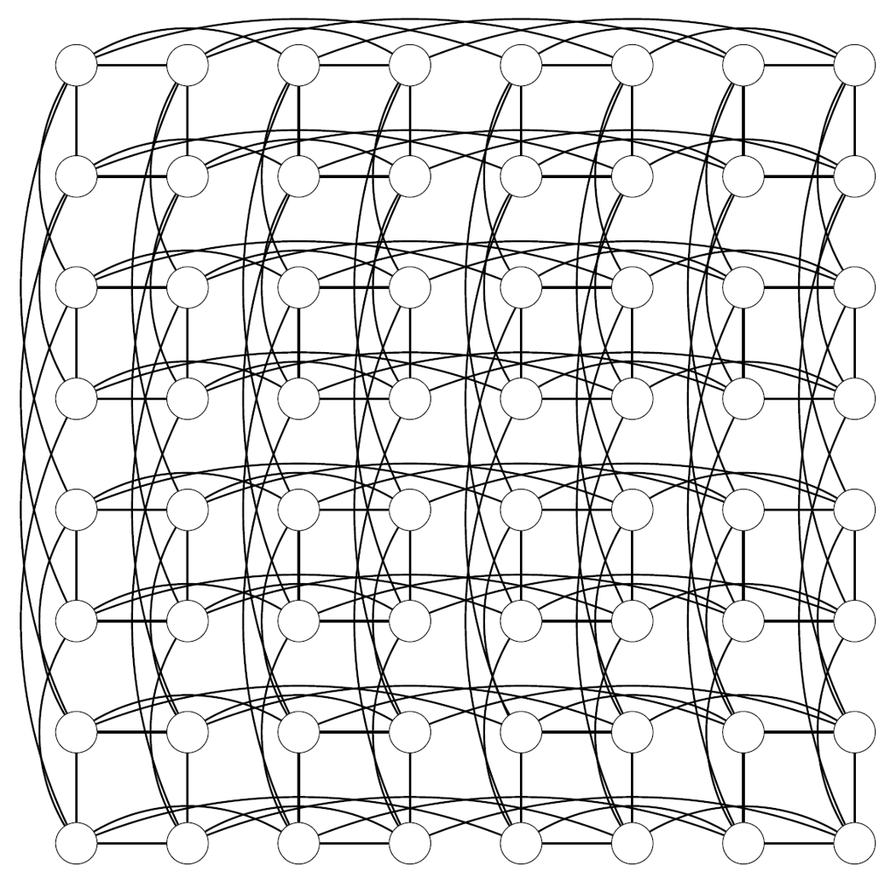
Hypercube to 2D mesh
Map (log p)-dim hypercube into √p x √p mesh.
Assume √p for simplicity is a power of 2, and let q = log √p = (log p) / 2.
If we fix the first or last q digits of the nodes in hypercube, we get another q-dim hypercube.
Ex Take 4-dim hypercube, and fix last two digits to 10. Then get another hypercube (0010, 0110, 1110, 1010).
For each q digit binary number r, map the hypercube from fixing the last q digits in hypercube to row r of mesh.
Use the hypercube to line mapping.
Congestion is √p / 2.
For each q digit binary number r, map the hypercube from fixing the first q digits in hypercube to column r of mesh.
Congestion in rows and column independent. So overall congestion is √p / 2.

Slide 28
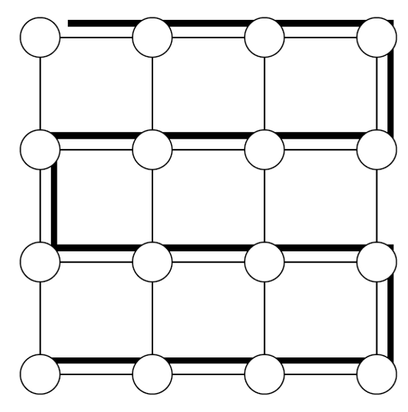
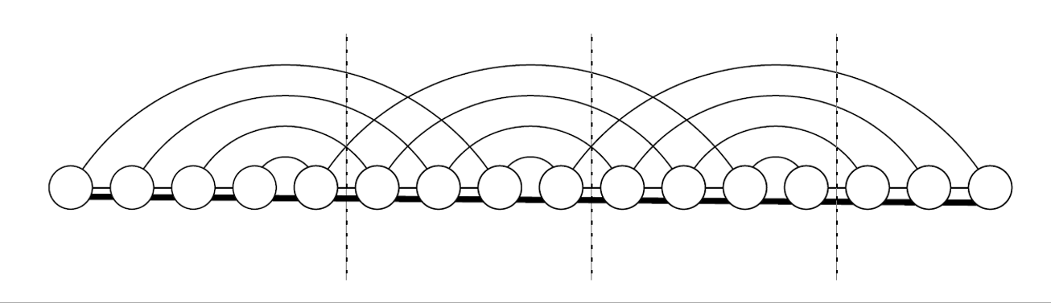
Line and mesh
Line maps into mesh using zig-zag embedding.
Congestion and dilation are 1.
To map mesh to line, invert the mapping.
For a √p x √p mesh, congestion is √p.
Every two consecutive rows must traverse edge connecting them in the line graph.
Dilation is 2√p – 1, between the first nodes in consecutive rows.

Slide 29
Cost performance tradeoffs
Cost of a network can be measured in terms of e.g. number of wires, bisection width (complexity), etc.
Wire complexity Square p node mesh has with O(log p) wires per link has same cost as p node hypercube.
Average distance in mesh is O(√p), and in hypercube is O(log p).
With O(log p) wires per link in mesh, t_{w} gets reduced by O(log p) factor.
Avg latency in mesh is t_{s} + O(t_{h}√p) + O(m t_{w} / log p).
Avg latency in hypercube is t_{s} + O(t_{h} log p) + m t_{w}.
For fixed number of processors and large message size, m t_{w} >> t_{h}, so mesh has lower latency.
Hypercube better under contention, since it has much greater bisection width.

